Slide 1
Superstore Sales Analysis
DEPI

Slide 2
Agenda
01
02
03
The Datasets and Cleaning
The Problems and Proposed Solutions
Exploring the dataset and cleaning it.
Analyzing and interpreting data-driven solutions
Thank You
we are grateful for your kind listening

Slide 3
01
The Datasets and Cleaning
Exploring the dataset and cleaning it.

Slide 4
The Datasets and Cleaning
The datasets is 9800 record in 18 rows.
The cleaning of the data consisted of:
Removing nulls in postal code columns
Dropping duplicates.
Removing outliers.
Converting the order date and shipping date to datetime.

Slide 5
02
The Problems and Proposed Solutions
Analyzing and interpreting data-driven solutions

Slide 6
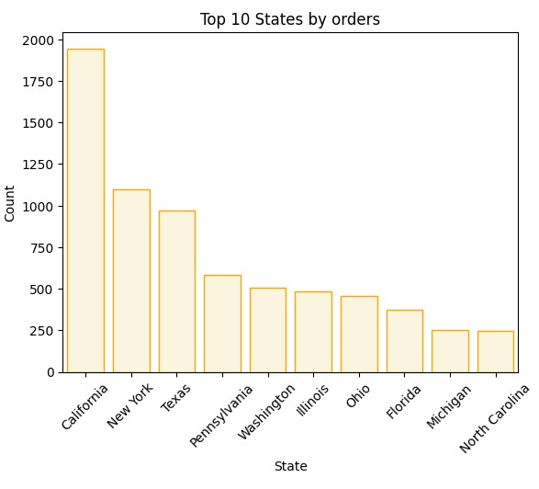
Uneven Distribution of Sales over the States
California leads in order volume, while Florida and Michigan show low orders, highlighting the need for targeted marketing strategies to boost demand in these states in the time that the population of Florida or Michigan is higher than the population of California
Solution:
Bundling Promotions: Offer low-selling items in promotional deals with best-sellers to increase their sales.
Attract New Customers: Target new customer segments that may require low-performing products.

Slide 7
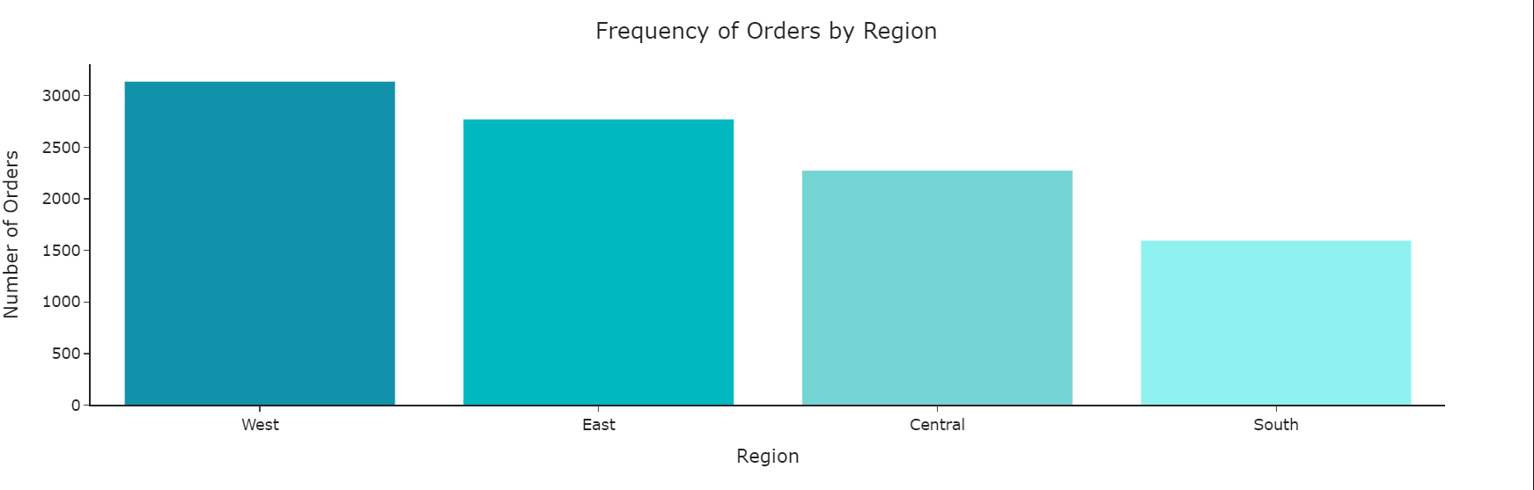
The Distribution of Sales Across Regions
The main challenge is weak demand in the South due to ineffective marketing and limited access to products. Solutions include conducting market analysis, increasing store presence, rebranding marketing campaigns, and providing targeted incentives to stimulate demand.
Solutions:
Conduct Market Analysis
Increase Store Locations
Strengthen Distribution Networks
Digital & Offline Ads
Customer Education
Customized Discounts & Offers
Seasonal and Holiday Promotions

Slide 8
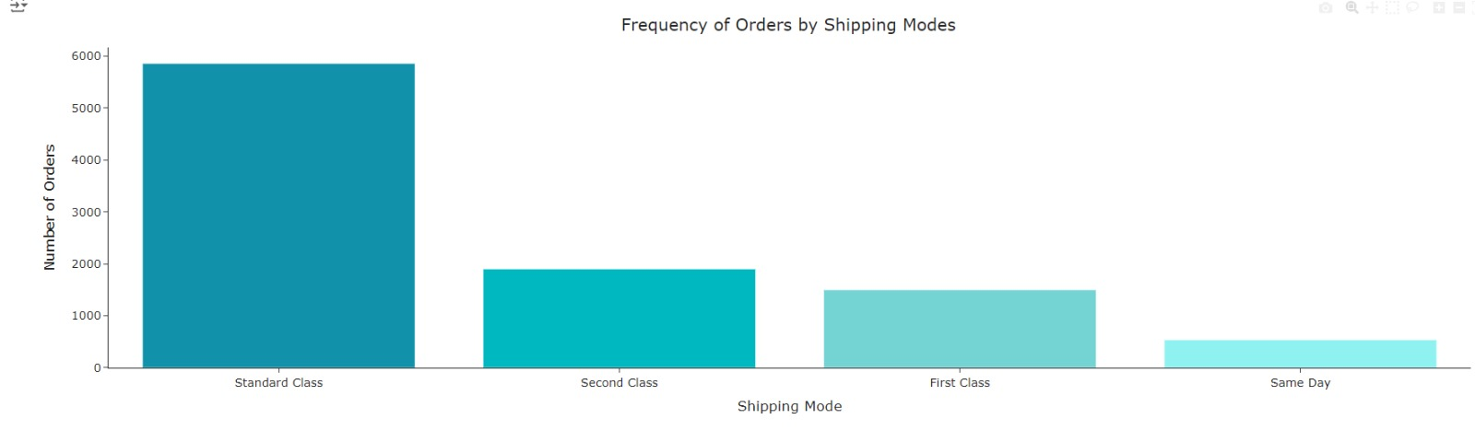
Shipping Problems and the Impact on the Sales
Solutions:
Analyze Shipping Costs and Customer Satisfaction: Conduct a study to understand why customers prefer standard shipping, possibly due to lower costs. Offer discounts or promotions on faster shipping options to encourage usage, like free expedited shipping over a certain spending threshold.
Increase Awareness of Faster Services
improve Fast Shipping Costs: If expedited shipping costs are too high, it may deter orders. Negotiate with shipping companies for reduced rates and offer limited-time discounts on same-day shipping.
The main challenge is to increase the use of faster shipping options like First Class and Same Day without negatively impacting customer experience or service costs. Proposed solutions focus on reducing costs, raising awareness of faster services, and incentivizing customers to try these options.

Slide 9
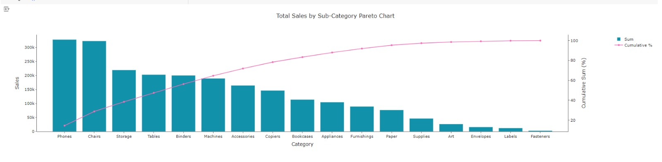
Dependence on Specific Products That Has Big Influence on the Sales
Heavy reliance on a few categories for most revenue can be risky. If these categories are negatively affected by factors like decreased demand or supply issues, total revenue may suffer.
Solutions:
Product Diversification Strategy: While high-performing categories are crucial, developing other categories through targeted marketing campaigns or product enhancements is essential.
Analyze Success Factors: Conduct a detailed analysis of high-selling categories to understand their success (e.g., product quality, appropriate pricing, effective promotions) and apply these strategies to lower-performing categories.
Low-Selling Categories: Categories like nails, stickers, and envelopes show minimal sales contribution.

Slide 10
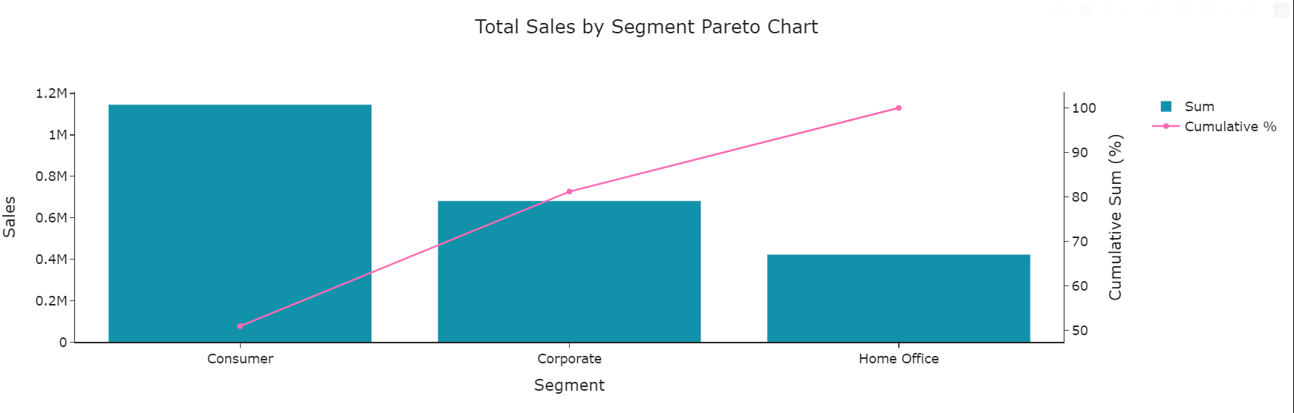
The Uneven Distribution of Sales between Consumers
Solutions:
Diversify the Market Base: Focus on increasing sales in corporate and home office sectors to reduce reliance on the consumer sector through targeted promotional strategies.
Enhance Marketing Efforts for the Corporate Sector: Develop specialized products and services for businesses, offering significant discounts for bulk purchases.
Target Home Offices with New Products: Address the needs of remote workers with ergonomic office furniture and technology solutions.
The main challenge is the heavy reliance on the consumer sector for sales, which poses risks if demand fluctuates. Solutions include diversifying into corporate and home office markets, enhancing marketing efforts, and developing new products tailored for remote workers.
Competitive Analysis: Monitor competitors and adapt strategies based on market changes.

Slide 11
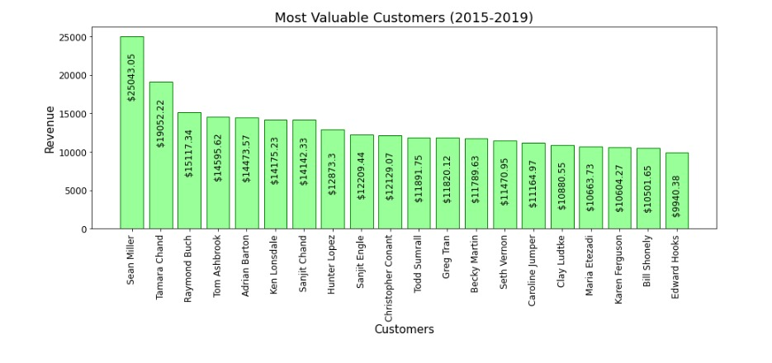
Significant Discrepancy Between the Top Costumers
The difference in revenue between the top costumers and the rest suggests a reliance on a few high-value customers, potentially increasing business risk. If these top customers reduce their purchase or switch to competitors, the company could face substantial revenue loss.
Solutions:
Diversify the Customer Base
Customer Retention Strategies
Cross-Sell and Upsell
Customer Feedback and Engagement
Risk Management

Slide 12
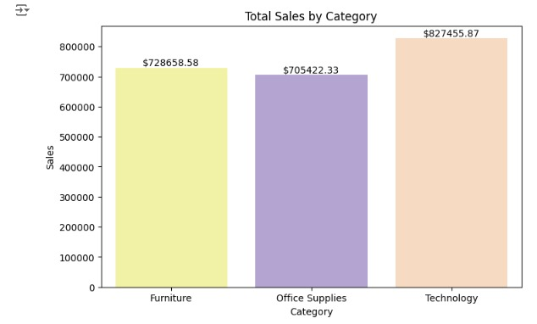
Imbalance Sales over Category
The differing purchase cycles of these categories can lead to fluctuating revenues, making it crucial for the business to address this imbalance.
Solutions:
Implement Targeted Marketing Strategies for Each Category.
Enhance Customer Experience.
Diversify Product Offerings and Discounts
Analyze Customer Data to Identify Purchasing Patterns.

Slide 13


